Slide 1
Report of Agile2014
As a Speaker and a Reporter
of the latest Agile in the world
Aug/07/2014
Hiroyuki Ito
Development Process Optimization Department, Rakuten, Inc.
http://www.rakuten.co.jp/
Notes:
Hello everyone.
In this session, I’d like to talk about “Technology-Driven Development”.

Slide 2
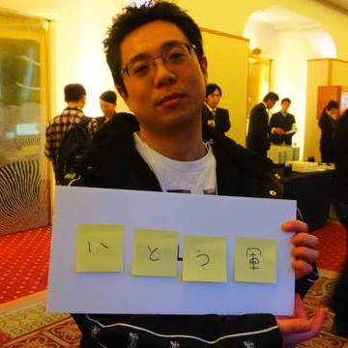
About me
Hiroyuki Ito
(The Hiro)
@hageyahhoo
Test-Driven
Development Group
Notes:
My name is Hiroyuki Ito.
Please call me “The Hiro”.
I’m from Japan.
I belong to “Test-Driven Development Group” in Rakuten.
I have 2 certifications of Scrum.
Now I’m working as an Agile Coach.

Slide 3
What is Agile2014?
Notes:
Again, this session’s theme is “Technology-Driven Development”.
Of course, this name is derived from “Test-Driven Development”.
Anyway, what is “Technology-Driven Development”?

Slide 4
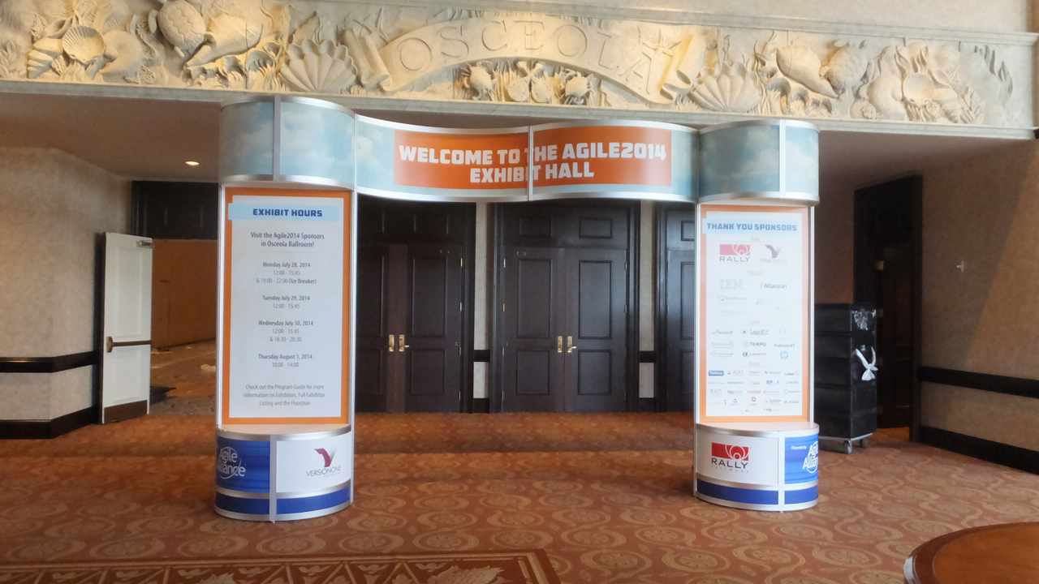



The world’s largest Agile Conference
WALL ATDD
WALL TDD
WALL CI/CD

Slide 5
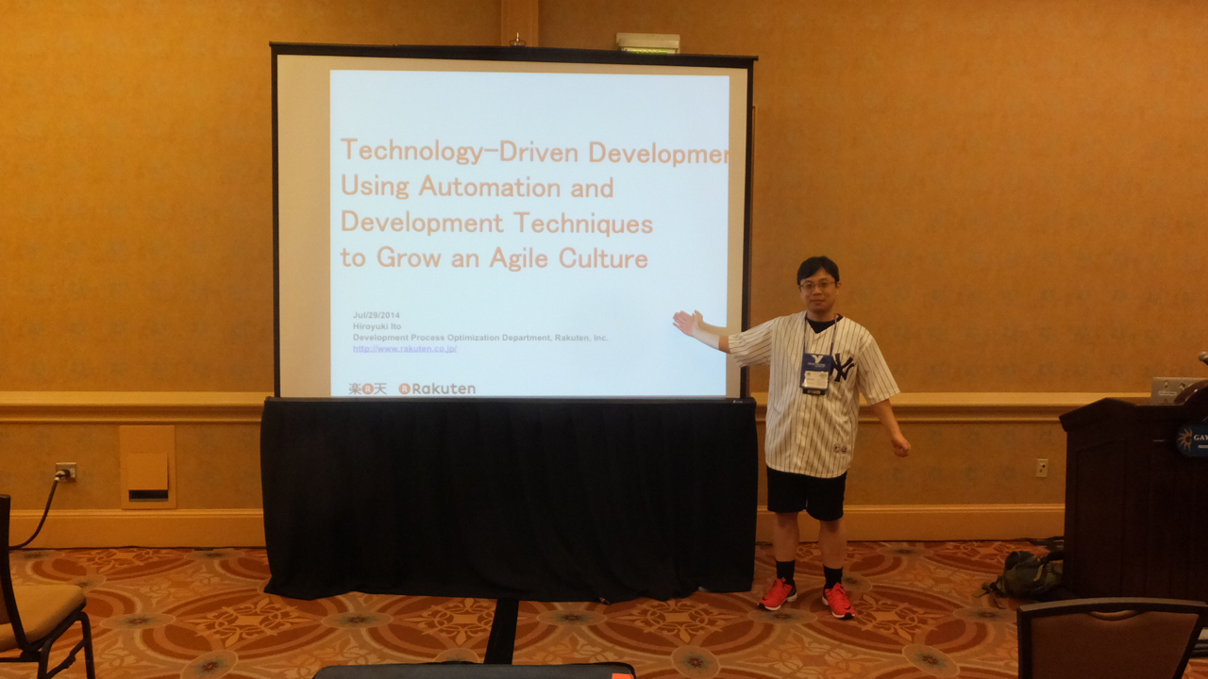
Attended as a session speaker!
Notes:
My name is Hiroyuki Ito.
Please call me “The Hiro”.
I’m from Japan.
I belong to “Test-Driven Development Group” in Rakuten.
I have 2 certifications of Scrum.
Now I’m working as an Agile Coach.

Slide 6
Agenda
1. Basic Information of Agile2014
2. My Presentation
3. The Latest Trend of Agile
4. Conclusions
Notes:
Here is this session’s agenda.
At first, I will talk about the conditions and the challenges of my project.
Next, I will explain the concrete approaches, CI/CD, TDD, and BDD.
After that, I will talk about the results, problems, possibilities, and the future of Technology-Driven Development.
At last I will conclude this report.

Slide 7
1. Basic Information of Agile2014
2. My Presentation
3. The Latest Trend of Agile
4. Conclusions
Notes:
Here is this session’s agenda.
At first, I will talk about the conditions and the challenges of my project.
Next, I will explain the concrete approaches, CI/CD, TDD, and BDD.
After that, I will talk about the results, problems, possibilities, and the future of Technology-Driven Development.
At last I will conclude this report.

Slide 8
Basic information
Location | Orlando, Florida, U.S.
Duration | 4.5 days
Attendees | Approximately 2000 persons
Sessions | 272 sessions
Session Speakers | Over 280 persons
Notes:
Therefore, I was highly-motivated!

Slide 9
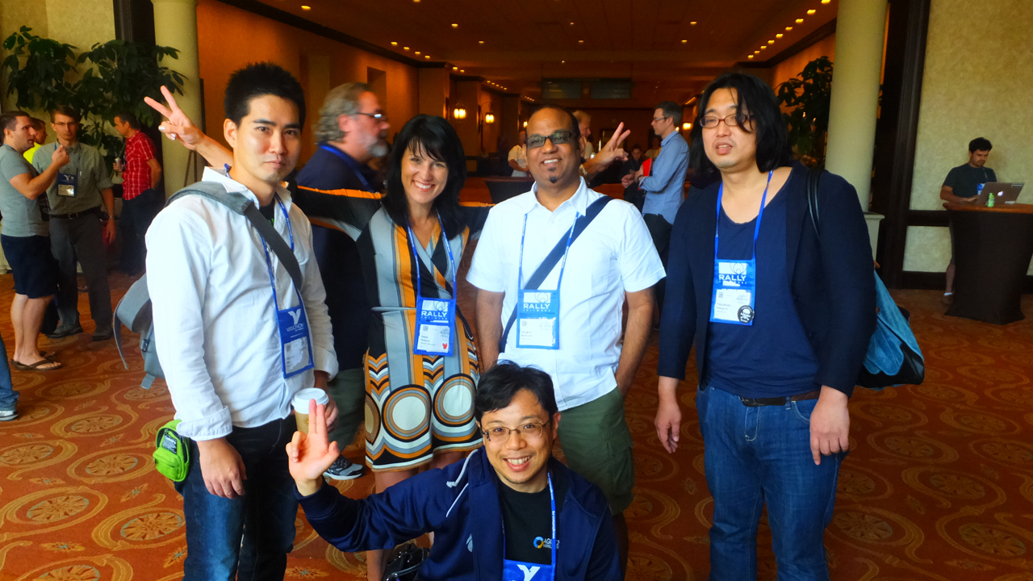
Rakuten all superstars!
Dana (R Marketing)
Pramod (PJM)
Abex (BDD)
Yasnob (TDD)
TheHiro (TDD)
Notes:
It means the new possibilities of Automation.

Slide 10
Trend of sessions
Category | Sessions | Memo
Agile Bootcamp | 7
Coaching & Mentoring | 16
Collaboration Culture & Teams | 23
Development Practices & Craftsmanship | 28
DevOps | 15
Enterprise Agile | 28
Experience Reports | 25 | TheHiro make a presentation here.
Keynote | 3
Leadership | 16
Learning | 15
Lightning Talks | 3
Open Jam | 4 | All day event held everyday.
Project Program and Portfolio Management | 24
Research | 9 | Including LT for researchers. 10 min/person.
Special Events | 9 | Including parties.
Stalwarts | 8
Testing & Quality Assurance | 13
User Experience | 11
Working with Customers | 15
Total | 272

Slide 11
Comparison of trends
Category | Sessions |  |  | Memo
 | 2012 | 2013 | 2014
Adoption & Transformation | 26 | 0 | 0 | Divided into “Enterprise Agile”, “Learning”, and so on.
Agile Bootcamp | 7 | 7 | 7
Coaching & Mentoring | 15 | 15 | 16
Collaboration Culture & Teams | 18 | 15 | 23
Crouedsourced | 0 | 14 | 0 | Held only 2013.
Development Practices & Craftsmanship | 16 | 20 | 28
Distrubuted Agile | 5 | 0 | 0
DevOps | 0 | 13 | 15
Emerging Applications of Agile | 5 | 0 | 0
Enterprise Agile | 21 | 19 | 28
Experience Reports | 20 | 14 | 25
Keynote | 3 | 3 | 3
Leadership | 13 | 12 | 16
Lean Startup | 0 | 15 | 0 | Held only 2013.
Learning | 0 | 17 | 15
Lightning Talks | 0 | 0 | 3 | 10 min/person.
Open Jam | 26 | 4 | 4 | Including “Coaches Clinic” in 2012.
Project Program and Portfolio Management | 0 | 25 | 24
Research | 8 | 9 | 9 | Including LT for researchers.
Special Events | 9 | 8 | 9 | Including parties.
Stalwarts | 9 | 7 | 8
Testing & Quality Assurance | 12 | 11 | 13
User Experience | 12 | 14 | 11
Working with Customers | 17 | 17 | 15
Total | 242 | 259 | 272

Slide 12
1. Basic Information of Agile2014
2. My Presentation
3. The Latest Trend of Agile
4. Conclusions
Notes:
Here is this session’s agenda.
At first, I will talk about the conditions and the challenges of my project.
Next, I will explain the concrete approaches, CI/CD, TDD, and BDD.
After that, I will talk about the results, problems, possibilities, and the future of Technology-Driven Development.
At last I will conclude this report.

Slide 13
Information and documents
Session information
★
Paper published on Agile Alliance site
http://www.agilealliance.org/files/5014/0509/9284/ExperienceReport.2014.Ito.pdf
Presentation document published on Agile Alliance site
★
Notes:
These are top 3 challenges.

Slide 14
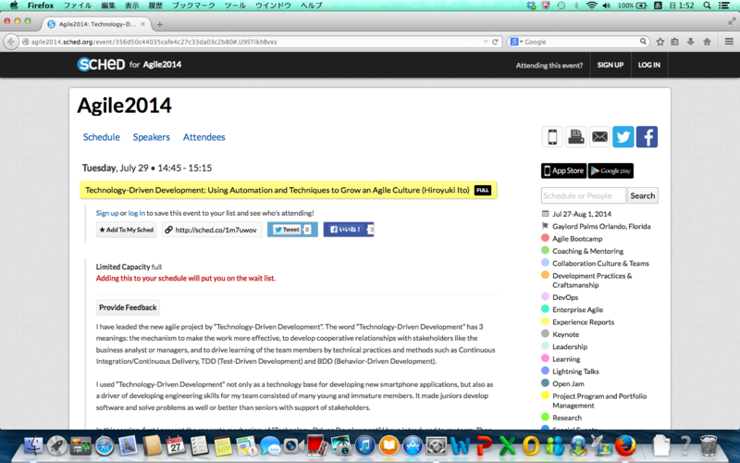
Before session
Notes:
My name is Hiroyuki Ito.
Please call me “The Hiro”.
I’m from Japan.
I belong to “Test-Driven Development Group” in Rakuten.
I have 2 certifications of Scrum.
Now I’m working as an Agile Coach.

Slide 15
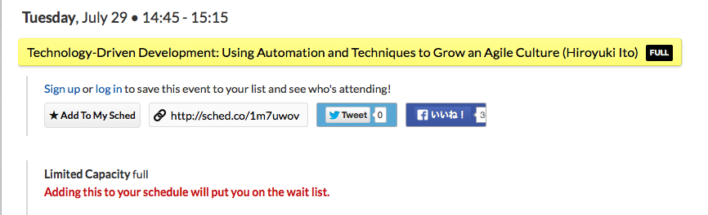
Before session (expanded)
Fully booked!?
(105 seats)
Notes:
My name is Hiroyuki Ito.
Please call me “The Hiro”.
I’m from Japan.
I belong to “Test-Driven Development Group” in Rakuten.
I have 2 certifications of Scrum.
Now I’m working as an Agile Coach.

Slide 16
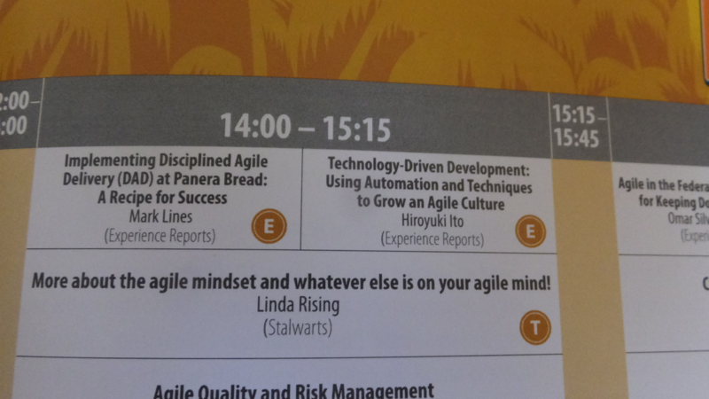
On session program
Notes:
My name is Hiroyuki Ito.
Please call me “The Hiro”.
I’m from Japan.
I belong to “Test-Driven Development Group” in Rakuten.
I have 2 certifications of Scrum.
Now I’m working as an Agile Coach.

Slide 17
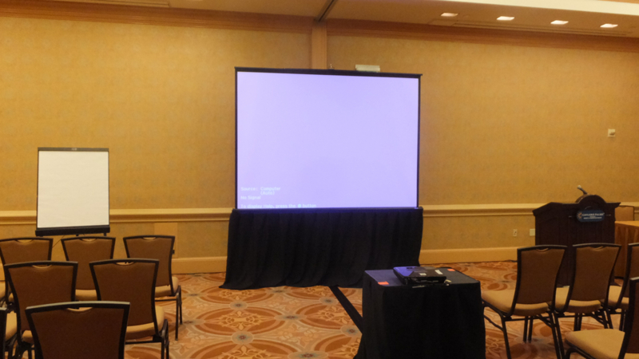
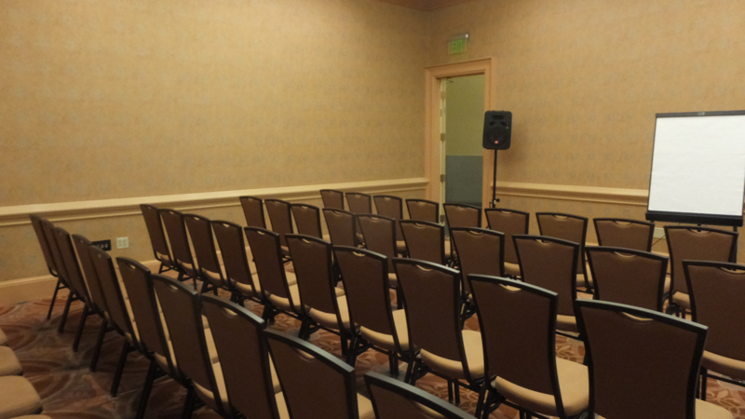
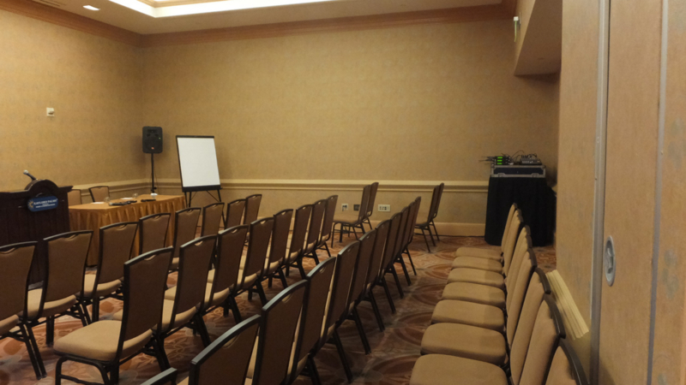
Venue
Notes:
My name is Hiroyuki Ito.
Please call me “The Hiro”.
I’m from Japan.
I belong to “Test-Driven Development Group” in Rakuten.
I have 2 certifications of Scrum.
Now I’m working as an Agile Coach.

Slide 18
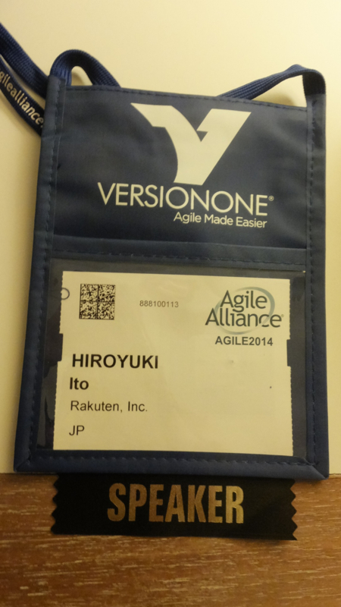
Key item as a speaker
Notes:
My name is Hiroyuki Ito.
Please call me “The Hiro”.
I’m from Japan.
I belong to “Test-Driven Development Group” in Rakuten.
I have 2 certifications of Scrum.
Now I’m working as an Agile Coach.

Slide 19
Image of presentation
Notes:
My name is Hiroyuki Ito.
Please call me “The Hiro”.
I’m from Japan.
I belong to “Test-Driven Development Group” in Rakuten.
I have 2 certifications of Scrum.
Now I’m working as an Agile Coach.

Slide 20
Result
About 60 persons attended.
Attendance Ratio = 57%
Average : about 50% (-> GOOD!)
Only 3 persons left during my presentation.
Remaining Ratio = 95%
Average : about 80% (-> GOOD!)
My shepherds often reacted positively during my presentation.
He is a real SAMURAI! (-> Maybe good ☺)
Notes:
These are top 3 challenges.

Slide 21
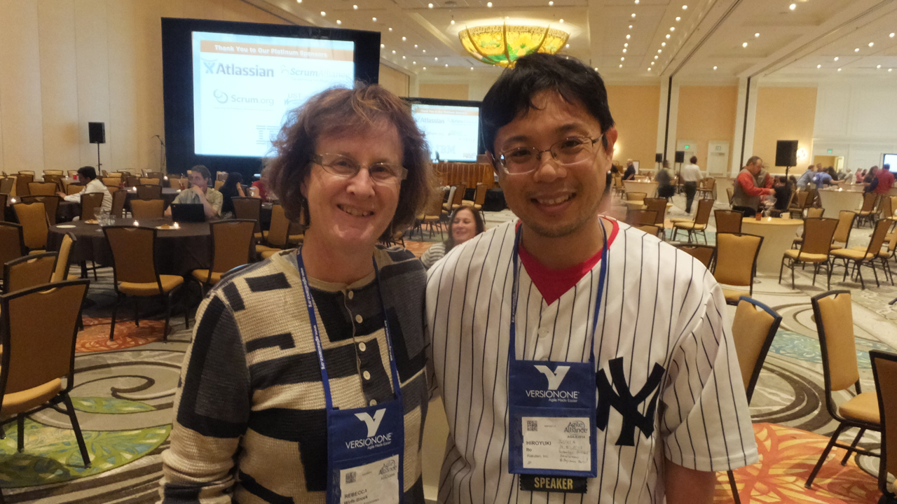
Rebecca Wirfs-Brock: Track chair
Notes:
My name is Hiroyuki Ito.
Please call me “The Hiro”.
I’m from Japan.
I belong to “Test-Driven Development Group” in Rakuten.
I have 2 certifications of Scrum.
Now I’m working as an Agile Coach.

Slide 22
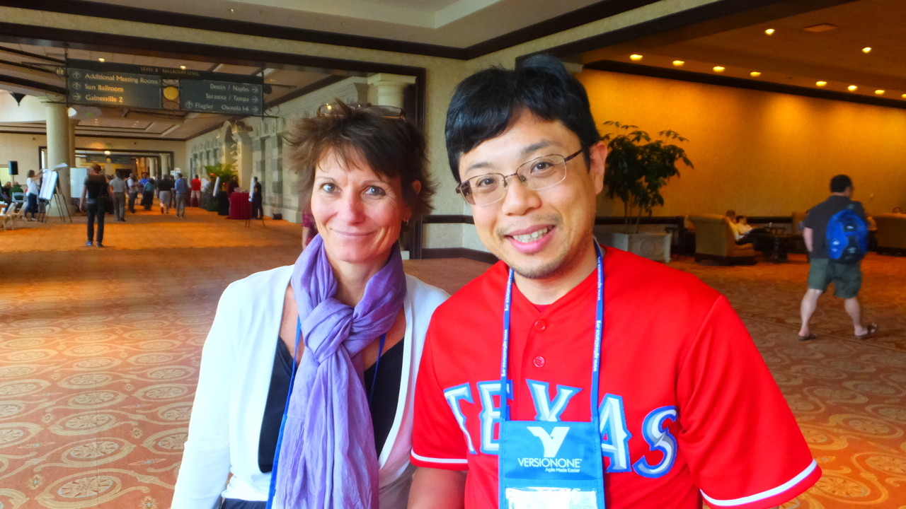
Jutta Eckstein: My shepherd
Notes:
My name is Hiroyuki Ito.
Please call me “The Hiro”.
I’m from Japan.
I belong to “Test-Driven Development Group” in Rakuten.
I have 2 certifications of Scrum.
Now I’m working as an Agile Coach.

Slide 23
Impression
Englishnization is useful.
I had no trouble
making a presentation with English.
speaking in front of many English native speakers.
Practicing a presentation was very useful.
Feedback is very important before the real presentation.
Rakuten members gave me a lot of insightful feedbacks before the conference.
Writing a paper was very useful for
clarifying ideas got through your work.
acquiring how to think, evaluate, and explain objectively.
publishing ideas throughout the world easily and fast.
Notes:
These are top 3 challenges.

Slide 24
Next Action
Attend as a speaker again!
I have some themes
Advanced testing
Improve by metrics
Nurture younger members and colleagues
for consistent growth of our company.
Write and submit papers
Attend the next conference as a speaker
Notes:
These are top 3 challenges.

Slide 25
1. Basic Information of Agile2014
2. My Presentation
3. The Latest Trend of Agile
4. Conclusions
Notes:
Here is this session’s agenda.
At first, I will talk about the conditions and the challenges of my project.
Next, I will explain the concrete approaches, CI/CD, TDD, and BDD.
After that, I will talk about the results, problems, possibilities, and the future of Technology-Driven Development.
At last I will conclude this report.

Slide 26
Previous Agile
Value
Agile/Scrum/Lean
Notes:
Again, this session’s theme is “Technology-Driven Development”.
Of course, this name is derived from “Test-Driven Development”.
Anyway, what is “Technology-Driven Development”?

Slide 27
The latest Agile
Testing
BDD/ATDD/ET/MT
Metrics
CFD/Kanban/KPIs
Value
Enterprise Agile
Organizational Change/Psychology
Agile/Scrum/Lean
Notes:
Again, this session’s theme is “Technology-Driven Development”.
Of course, this name is derived from “Test-Driven Development”.
Anyway, what is “Technology-Driven Development”?

Slide 28
1. Enterprise Agile
Testing
BDD/ATDD/ET/MT
Metrics
CFD/Kanban/KPIs
Value
Enterprise Agile
Organizational Change/Psychology
Agile/Scrum/Lean
Notes:
Again, this session’s theme is “Technology-Driven Development”.
Of course, this name is derived from “Test-Driven Development”.
Anyway, what is “Technology-Driven Development”?

Slide 29
Enterprise Agile
Developers
Executive
Business
Analyst
Agile Coach
(The Hiro)
UI/UX
Designers
Manager
Over barriers/silos

Slide 30
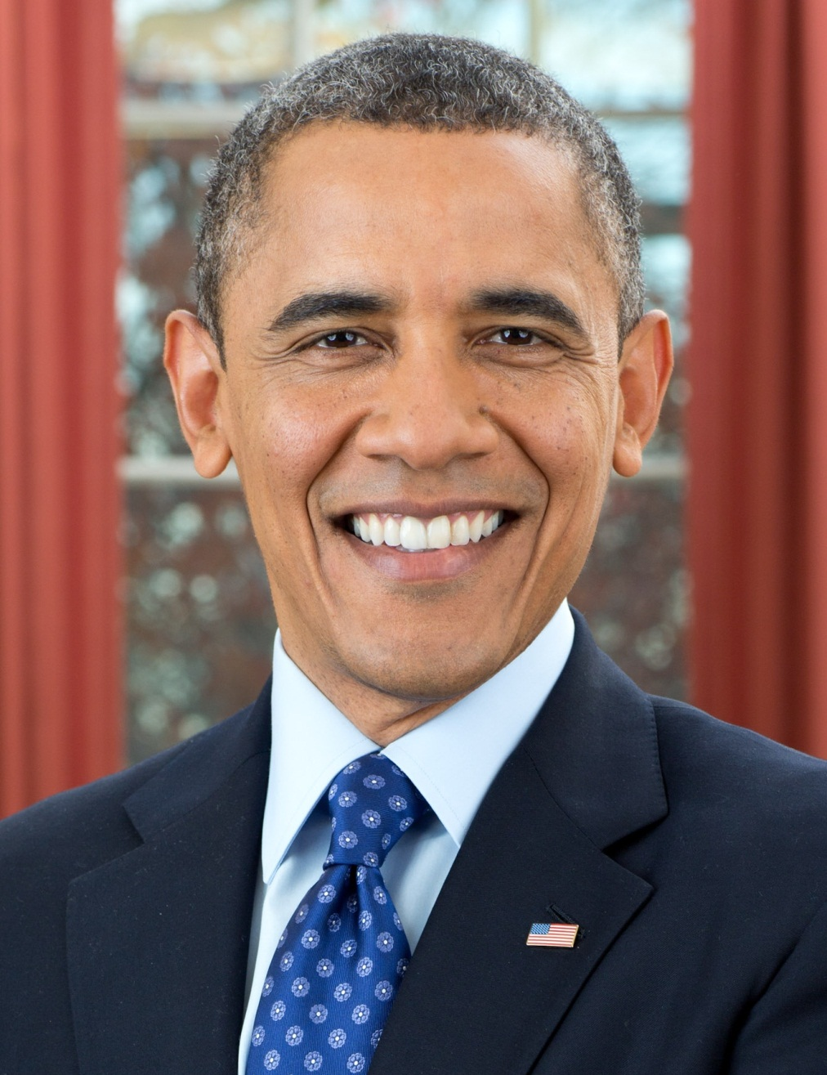
Asked for one executive
YES, YOU CAN!
We changed scope!

Slide 31
This session’s theme
Need
Technical
Foundation
Notes:
Again, this session’s theme is “Technology-Driven Development”.
Of course, this name is derived from “Test-Driven Development”.
Anyway, what is “Technology-Driven Development”?

Slide 32



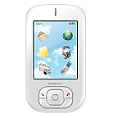
The Implementation of CI/CD in our project
Check-in build (hourly)
My PC
Deliver to
all team members
automatically
Build applications
and run regression tests automatically
We demonstrate latest application
to the business analyst and managers
in every daily scrum

Slide 33
Shared understanding by the working software
Developers
Business
Analyst
Know about
the progress
Get fast feedback
UI/UX
Designers

Slide 34
2. Testing
Testing
BDD/ATDD/ET/MT
Metrics
CFD/Kanban/KPIs
Value
Enterprise Agile
Organizational Change/Psychology
Agile/Scrum/Lean
Notes:
Again, this session’s theme is “Technology-Driven Development”.
Of course, this name is derived from “Test-Driven Development”.
Anyway, what is “Technology-Driven Development”?

Slide 35
Example of BDD test scenario with Calabash-Android
Feature : name of all cases
Scenario : name of each case
Feature: Input
Scenario: Input today’s data
Given I kick drumroll
And drumroll show today
When press next
Then I should see ”xxx" screen
When I press keys and calculator should show like this:
| 2 | 2 |
| 0 | 20 |
| 0 | 200 |
| * | 200 |
| 3 | 3 |
| = | 600 |
Then take photo
…
These statements are
RUNNABLE!
We can write data
with table style like this
Notes:
Here is the example of BDD test scenarios.

Slide 36
Process of BDD
Developers
Business
Analyst
We want to…
We want to…
UI/UX
Designers

Slide 37
Process of BDD
GIVEN …
WHEN …
THEN …
Developers
Business
Analyst
Is that right?
MORE!
MORE! MORE!
We want to…
UI/UX
Designers

Slide 38
Process of BDD
GIVEN …
WHEN …
THEN …
Developers
Business
Analyst
Is that right?
MORE!
MORE! MORE!
OK, go ahead!
UI/UX
Designers

Slide 39
Process of BDD
GIVEN …
WHEN …
THEN …
Developers
Business
Analyst
Is it OK?
UI/UX
Designers

Slide 40
Process of BDD
GIVEN …
WHEN …
THEN …
Developers
Business
Analyst
Is it OK?
MORE!
MORE! MORE!
Sure!
UI/UX
Designers

Slide 41
3. Metrics
Testing
BDD/ATDD/ET/MT
Metrics
CFD/Kanban/KPIs
Value
Enterprise Agile
Organizational Change/Psychology
Agile/Scrum/Lean
Notes:
Again, this session’s theme is “Technology-Driven Development”.
Of course, this name is derived from “Test-Driven Development”.
Anyway, what is “Technology-Driven Development”?

Slide 42
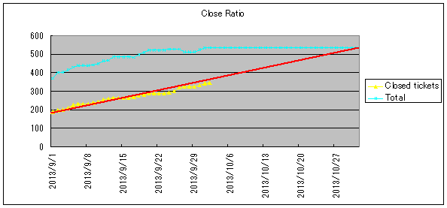
Metrics
[e.g.]
Change requests : 3 times/week
Regression testing : 3 minutes/change
Install applications : 2 minutes/change

Slide 43
KPIs
経営学＆科学的手法で実施している、
改善の仕組み化としての指標は出すべし

Slide 44

http://books.rakuten.co.jp/rk/91a2285c6f0b4fea867632bcd286bf1d/

Slide 45
1. Basic Information of Agile2014
2. My Presentation
3. The Latest Trend of Agile
4. Conclusions
Notes:
Here is this session’s agenda.
At first, I will talk about the conditions and the challenges of my project.
Next, I will explain the concrete approaches, CI/CD, TDD, and BDD.
After that, I will talk about the results, problems, possibilities, and the future of Technology-Driven Development.
At last I will conclude this report.

Slide 46
The world’s largest conference of Agile
XP Europe というものにも、
Agile2014 と同様
Paper & Shepherding process が
あるとのこと
by Jutta Eckstein

Slide 47

http://agile2015.agilealliance.org/

Slide 48
Information and documents
Session information
http://www.agilealliance.org/files/5014/0509/9284/ExperienceReport.2014.Ito.pdf
Paper published on Agile Alliance site
http://www.agilealliance.org/files/5014/0509/9284/ExperienceReport.2014.Ito.pdf
Presentation document published on Agile Alliance site
★
My blog
http://d.hatena.ne.jp/hageyahhoo/20140730/1406683408
Notes:
These are top 3 challenges.

